Slide 1
System Protection

Slide 2
Topics
Goals of protection
Principles of protection
Domain of protection
Access matrix
Implementation of Access matrix
Access control

Slide 3
Goals of Protection
In one protection model, computer consists of a collection of objects, hardware or software
Each object has a unique name and can be accessed through a well-defined set of operations
Protection problem - ensure that each object is accessed correctly and only by those processes that are allowed to do so

Slide 4
Principles of Protection
Guiding principle – principle of least privilege
Programs, users and systems should be given just enough privileges to perform their tasks
Properly set permissions can limit damage if entity has a bug, gets abused
Can be static (during life of system, during life of process
Or dynamic (changed by process as needed) – domain switching, privilege escalation

Slide 5
Domain of Protection
Computer can be treated as processes and objects
Hardware objects (such as devices) and software objects (such as files, programs, semaphores
Process for example should only have access to objects it currently requires to complete its task – the need-to-know principle
Implementation can be via process operating in a protection domain
Specifies resources process may access
Each domain specifies set of objects and types of operations on them
Ability to execute an operation on an object is an access right
Domains may share access rights
Associations can be static or dynamic
If dynamic, processes can domain switch

Slide 6
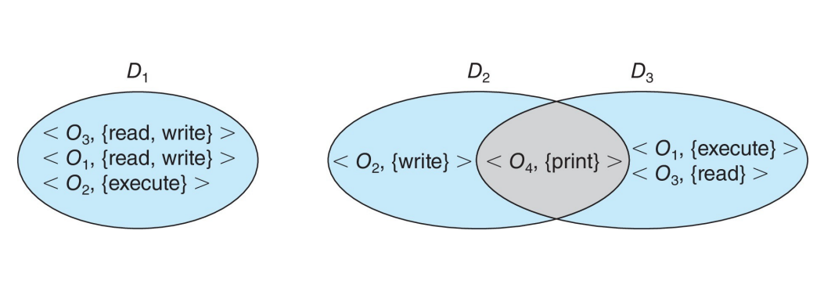
Domain Structure
Access-right = where rights-set is a subset of all valid operations that can be performed on the object
Domain = set of access-rights

Slide 7
Access Matrix
View protection as a matrix (access matrix)
Rows represent domains
Columns represent objects
Access(i, j) is the set of operations that a process executing in Domain can invoke on Object

Slide 8
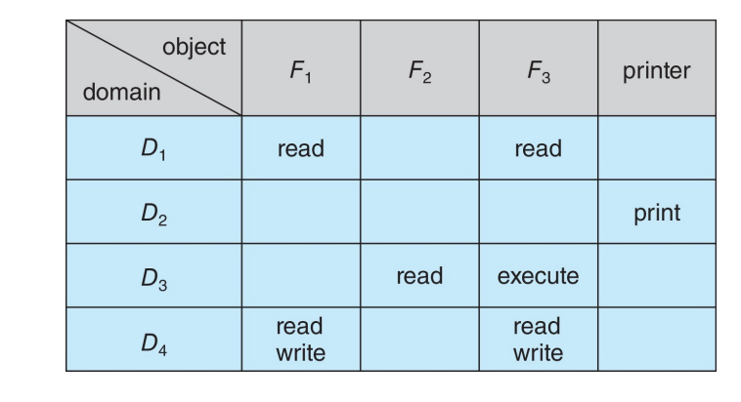
Access Matrix

Slide 9
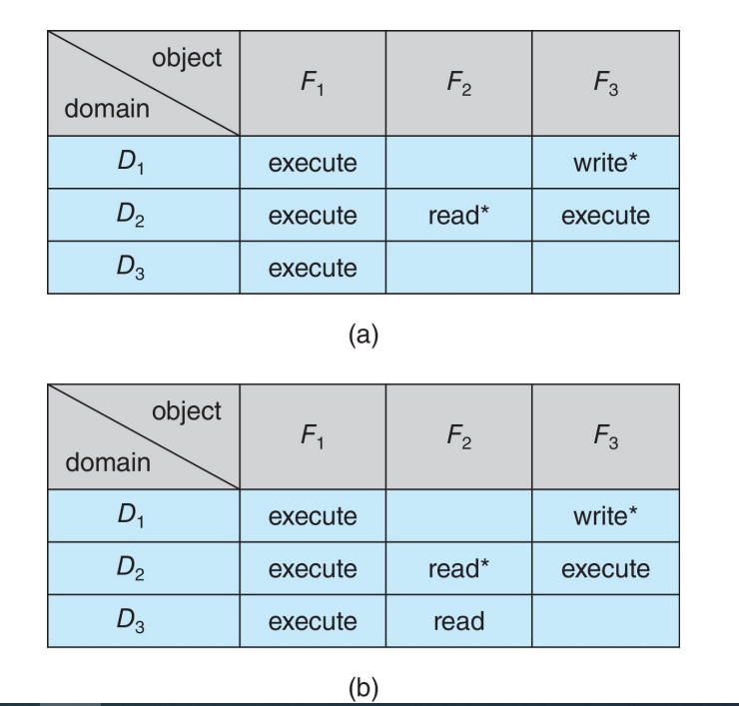
Access Matrix with Copy Rights
The ability to copy an access right from one domain (or row) of the access matrix to another is denoted by an asterisk (*) appended to the access right. The copy right allows the copying of the access right only within the column (that is, for the object) for which the right is defined. For example, in Figure (a), a process executing in domain D2 can copy the read operation into any entry associated with file F2. Hence, the access matrix of Figure (a) can be modified to the access matrix shown in Figure (b).

Slide 10
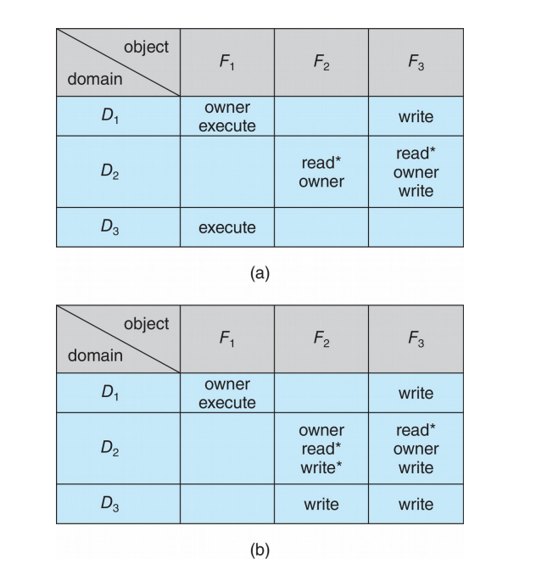
Access Matrix With Owner Rights
We also need a mechanism to allow addition of new rights and removal of some rights. The owner right controls these operations. If access(i,j) includes the owner right, then a process executing in domain D_{i} can add and remove any right in any entry in column j.
For example, in Figure (a), domain D₁ is the owner of F₁ and thus can add and delete any valid right in column F₁.
Similarly, domain D₂ is the owner of F₂ and F₃ and thus can add and remove any valid right within these two columns. Thus, the access matrix of Figure (a) can be modified to the access matrix shown in Figure (b).
The copy and owner rights allow a process to change the entries in a column. A mechanism is also needed to change the entries in a row.

Slide 11
Implementation of Access Matrix
There are various methods of implementing the access matrix in the operating system.
Global Table
Access Lists for Objects
Capability Lists for Domains
Lock-Key Mechanism

Slide 12
Global Table
It is the most basic access matrix implementation. A set of ordered triples <domain, object, rights-set> is maintained in a file. When an operation M has been performed on an object Oj within domain Di, the table is searched for a triple <Di, Oj, Rk>. The operation can proceed if this triple is located; otherwise, an exception (or error) condition has arrived. This implementation has various drawbacks. The table is generally large and cannot be stored in the main memory, so additional input and output are required

Slide 13
Access lists for objects
Every access matrix column may be used as a single object's access list. It is possible to delete the blank entries. For each object, the resulting list contains ordered pairs <domain, rights-set> that define all domains for that object and a nonempty set of access rights.

Slide 14
Capability Lists for Domains
A domain's capability list is a collection of objects and the actions that can be done on them. A capacity is a name or address that is used to define an object. If you want to perform operation M on object Oj, the process runs operation M, specifying the capability for object Oj. The simple possession of the capability implies that access is allowed.

Slide 15
Lock-Key Mechanism
Compromise between access lists and capability lists
Each object has list of unique bit patterns, called locks
Each domain as list of unique bit patterns called keys
Process in a domain can only access object if domain has key that matches one of the locks

